Slide 1


E-Banking
Presented By-
Sandhya Negi(229082)
Vaishnavi Ingole(229110)

Slide 2
Points to be discussed
Screenshots
Specification
Conclusion
Introduction
Motivation
Disadvantages
Future Enhancement
References
Advantages
S/W and H/W
Requirement
Objectives
UML Diagrams

Slide 3
Introduction
An e-banking is designed to provide online banking services to customers. It involves the development of a web-based platform that allows users to perform various banking activities.
The main objective of an e-banking project is to offer customers the convenience of accessing banking services anytime and anywhere they have an internet connection. This eliminates the need for physical visits to bank branches, allowing customers to manage their finances more efficiently.
Overall, an e-banking project can help banks improve customer satisfaction, reduce costs, and increase revenue by providing an efficient and convenient online banking service.

Slide 4
Motivation
E-banking provides customers with greater flexibility and convenience when it comes to managing their finances.

Slide 5
Objectives
Convenience: The primary objective of e-banking is to provide customers with a convenient and user-friendly platform for accessing banking services. Customers should be able to perform various transactions through the online platform.
Efficiency: E-banking aims to improve the efficiency of banking services by automating many processes, reducing the need for manual intervention, and enabling faster transactions. This can help banks reduce their operational costs and improve their overall productivity.
Accessibility: E-banking aims to make banking services more accessible to customers who may not be able to visit bank branches due to physical disabilities or geographical constraints.
Innovation: E-banking aims to foster innovation in banking services by enabling banks to introduce new products and services quickly and easily. The online platform should be flexible and scalable to accommodate new features and functions as required by changing customer needs and market trends.

Slide 6
Technology Used:
Front End: React
Back End: Java Spring Boot Api

Slide 7
UML Diagrams

Slide 8
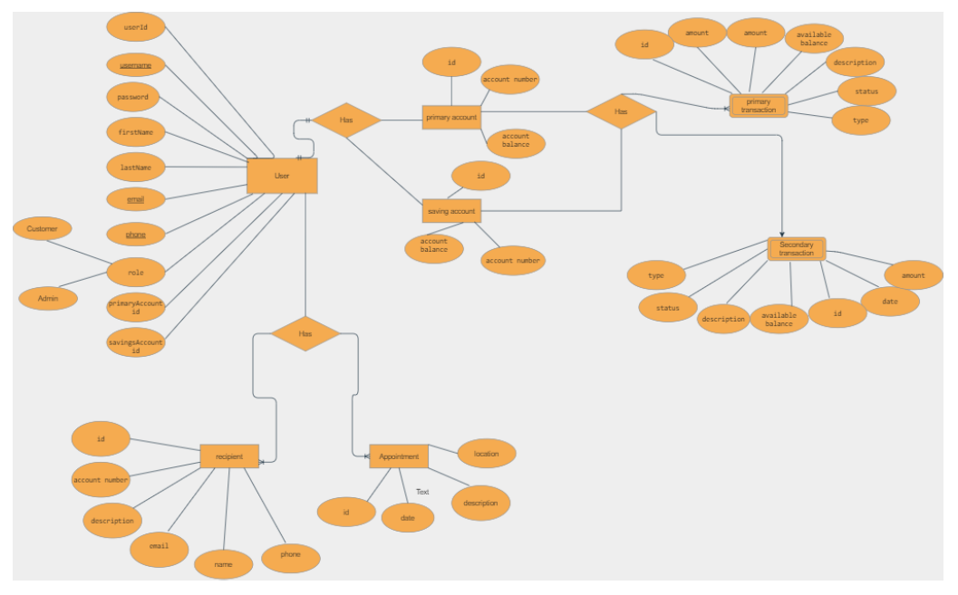
ER-Diagram

Slide 9
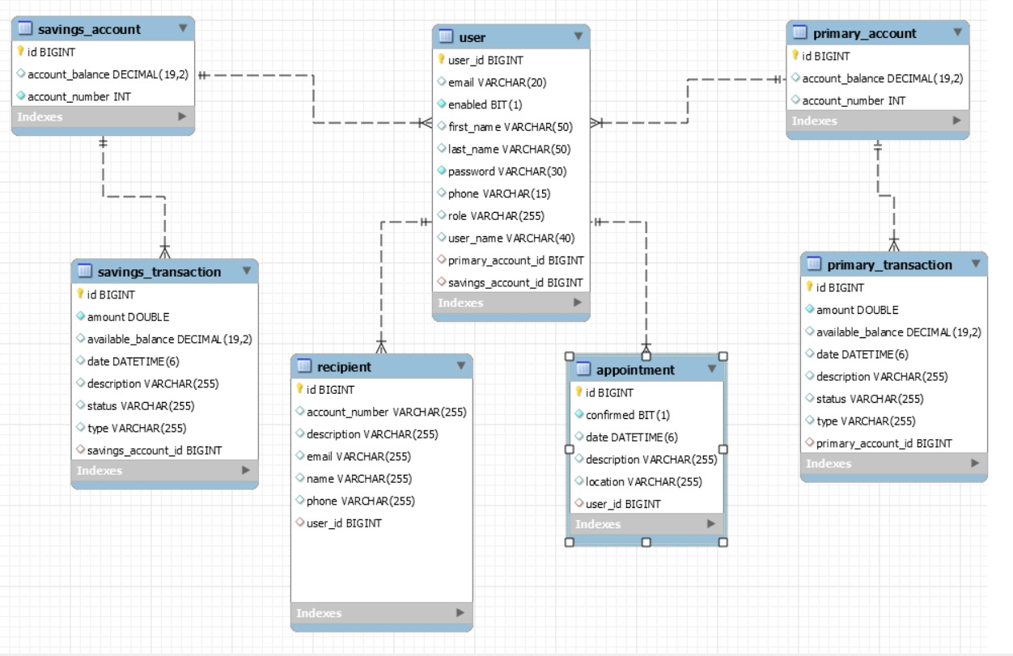
E-R Diagram(MySQL Auto generated)

Slide 10
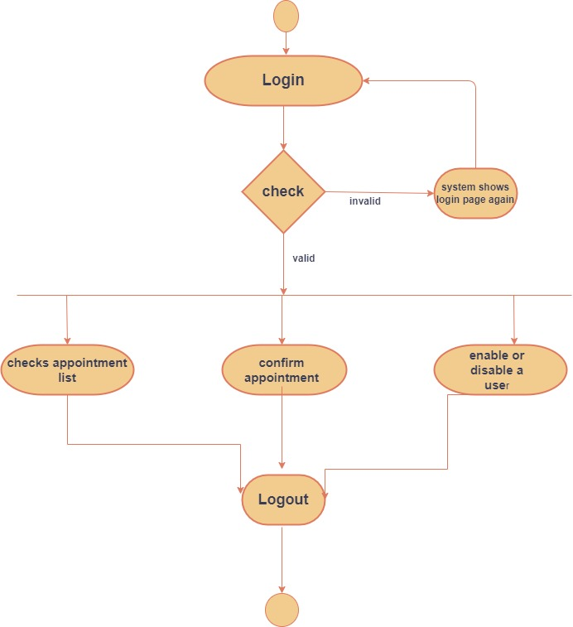
Activity Diagram
of Admin

Slide 11
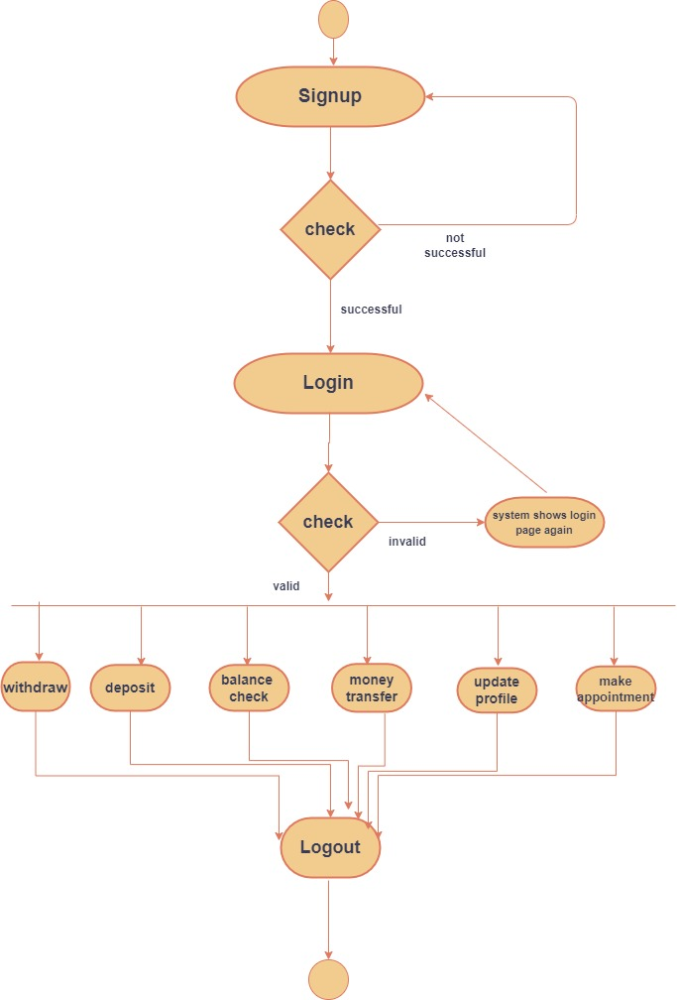
Activity Diagram
Of User

Slide 12
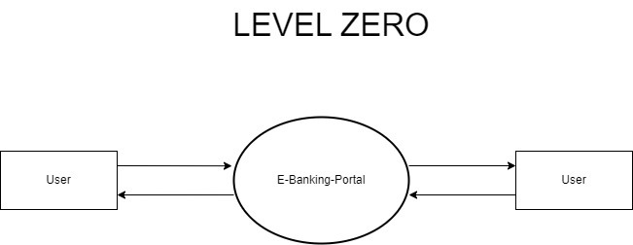
DFD Diagram

Slide 13
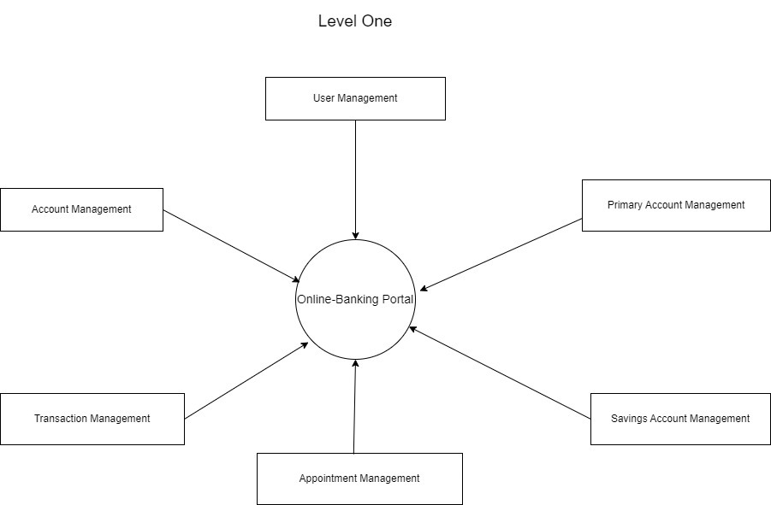

Slide 14
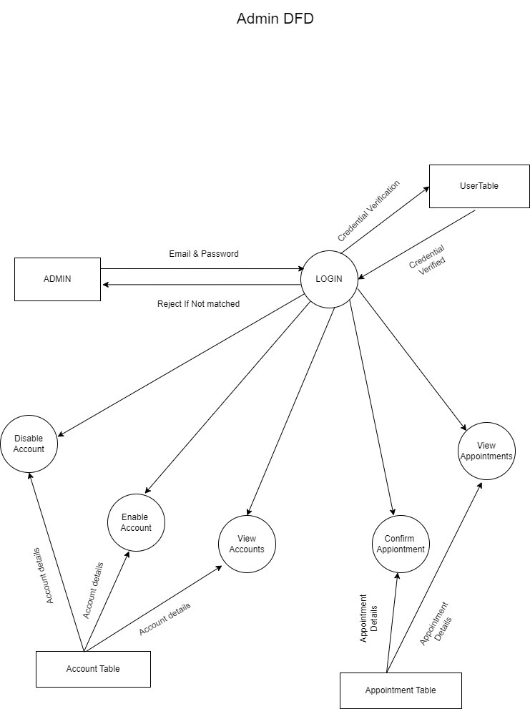
Admin DFD

Slide 15
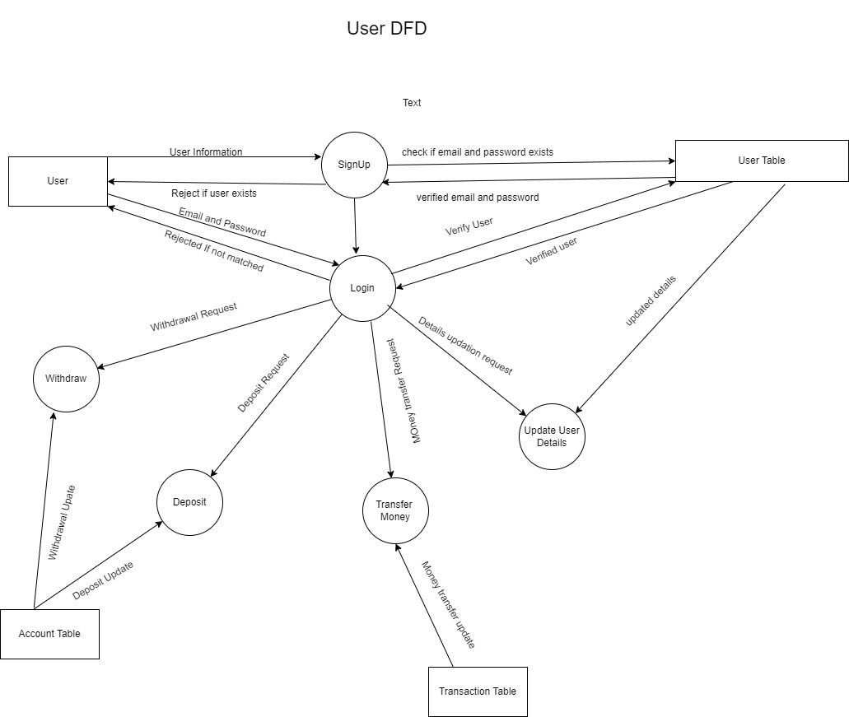
User DFD

Slide 16
Features of E-Banking

Slide 17
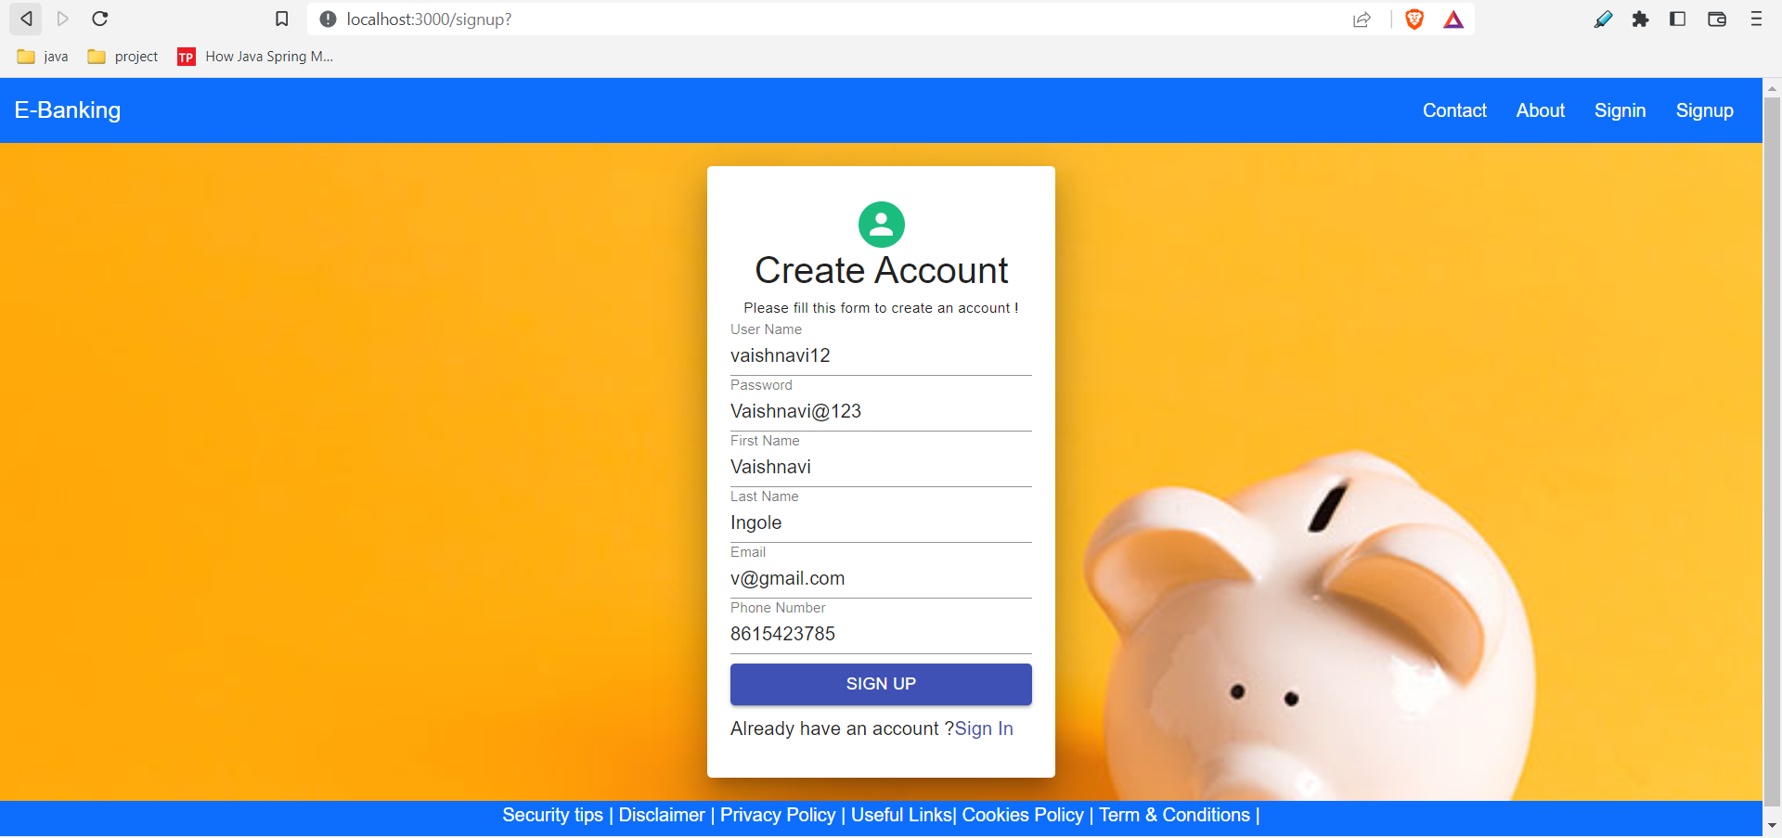
User Signup

Slide 18
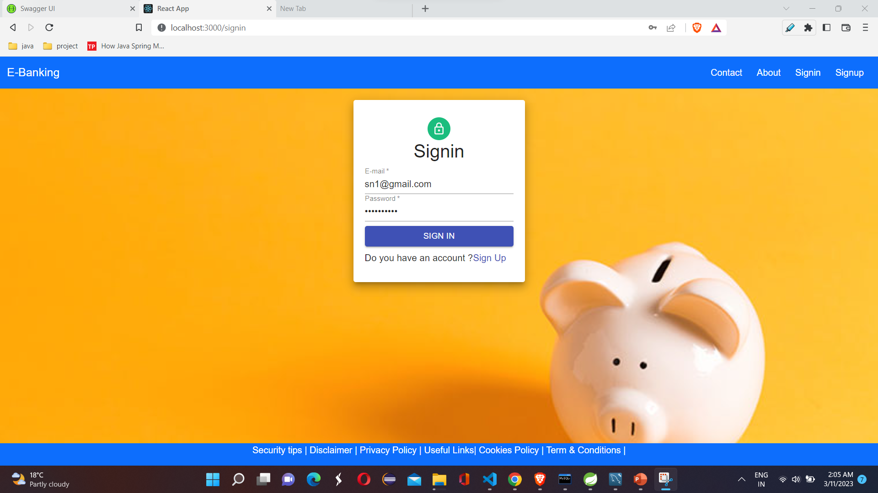
User Signin

Slide 19
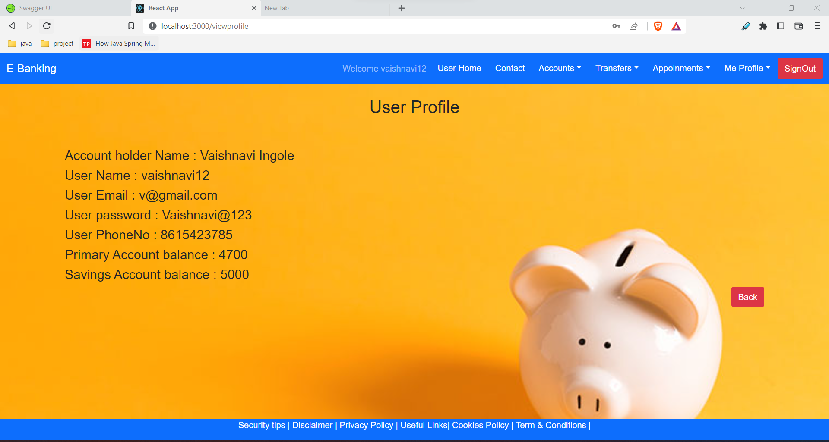
View Profile

Slide 20
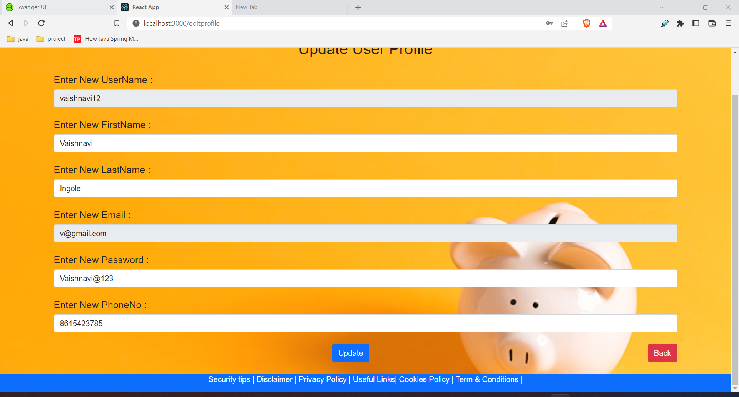
Update user profile

Slide 21
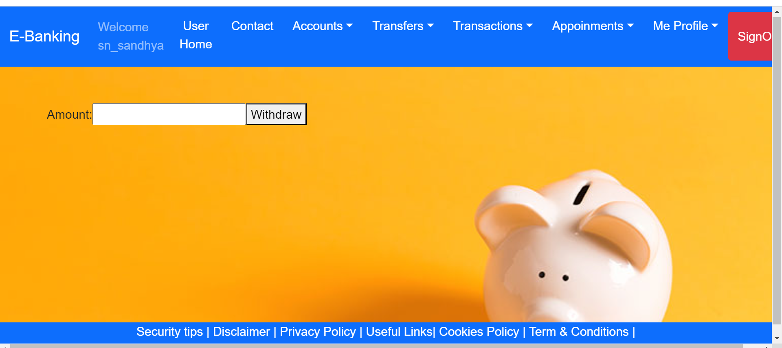
withdraw

Slide 22
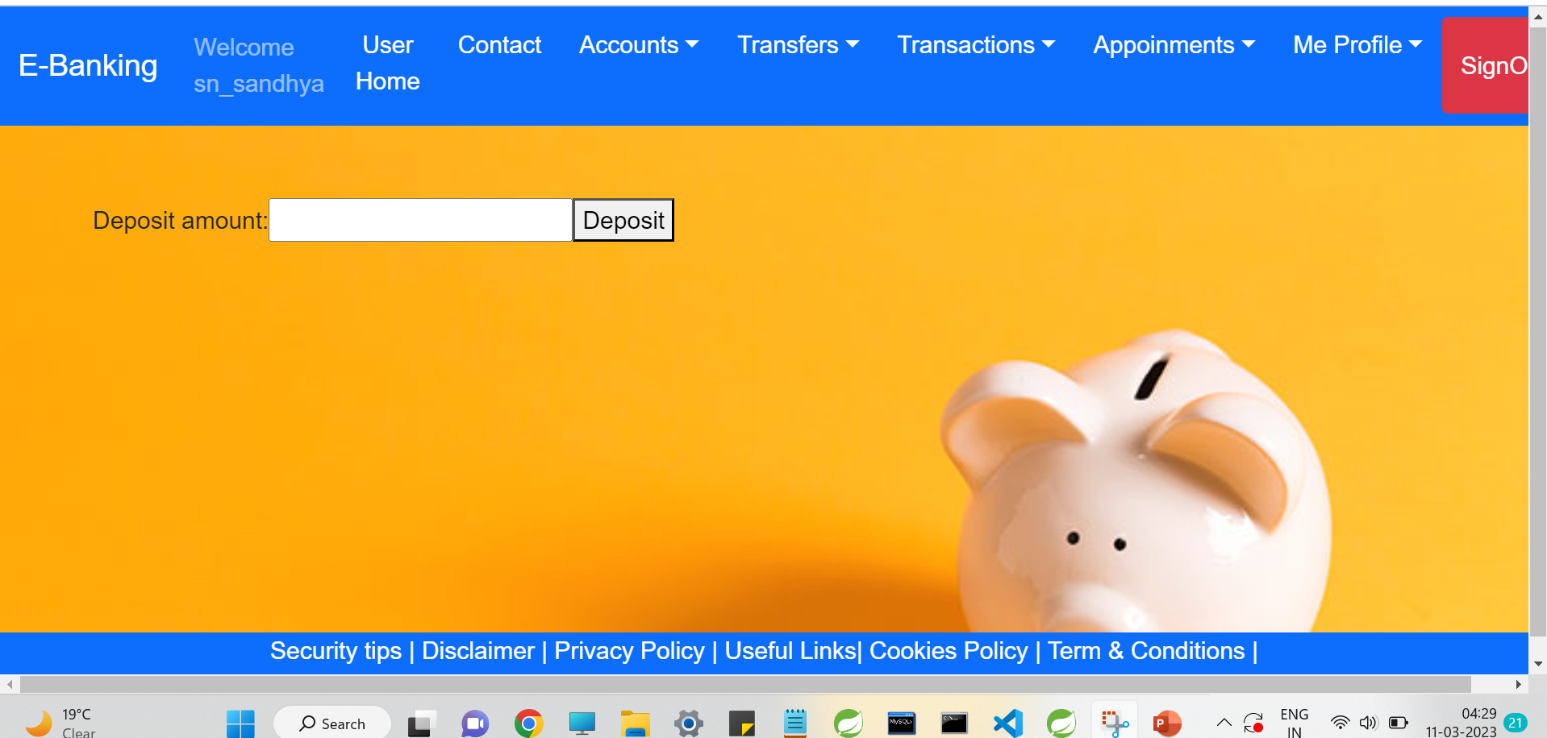
Deposit

Slide 23
Update user profile

Slide 24
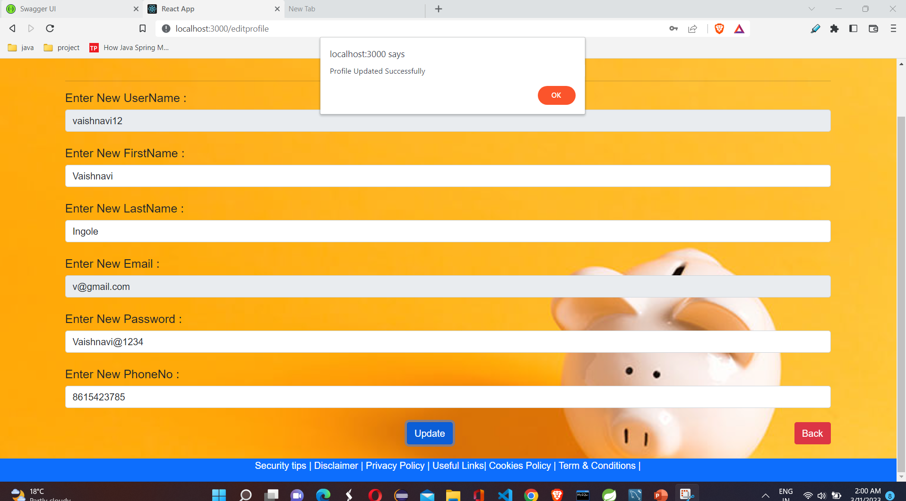

Slide 25
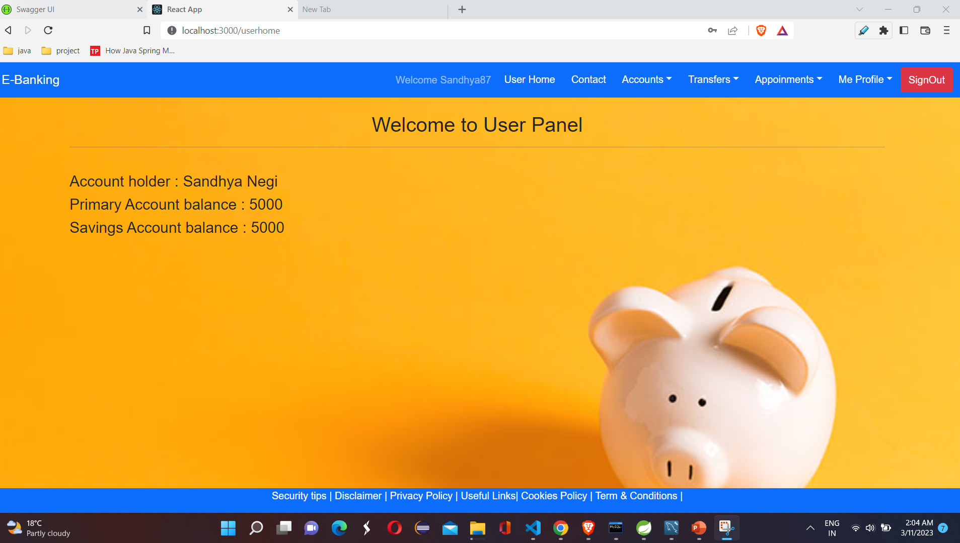

Slide 26
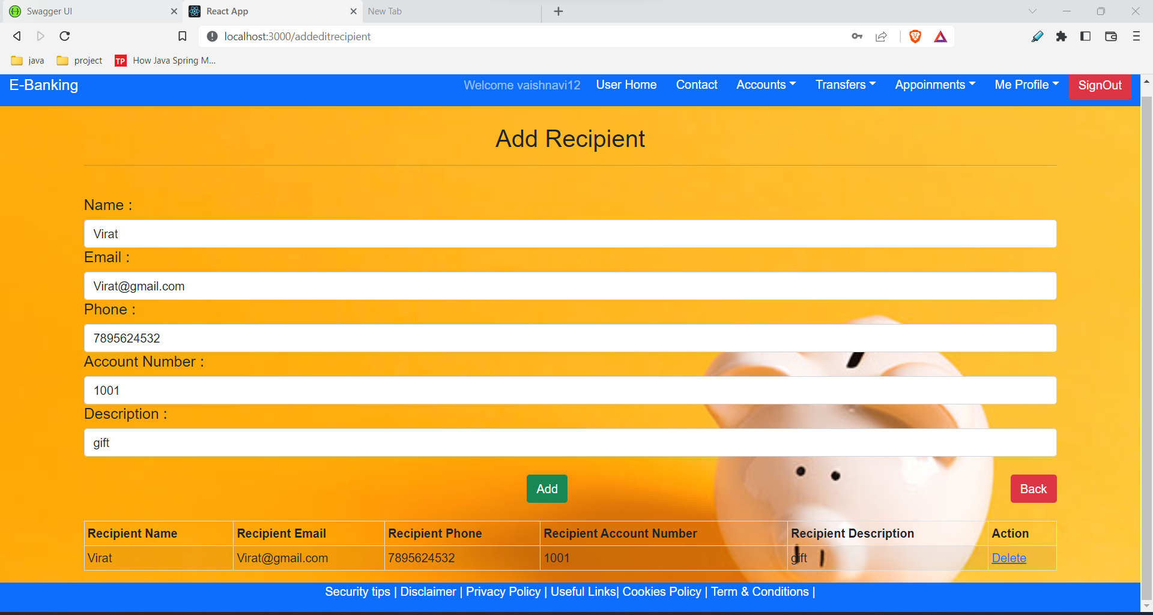

Slide 27
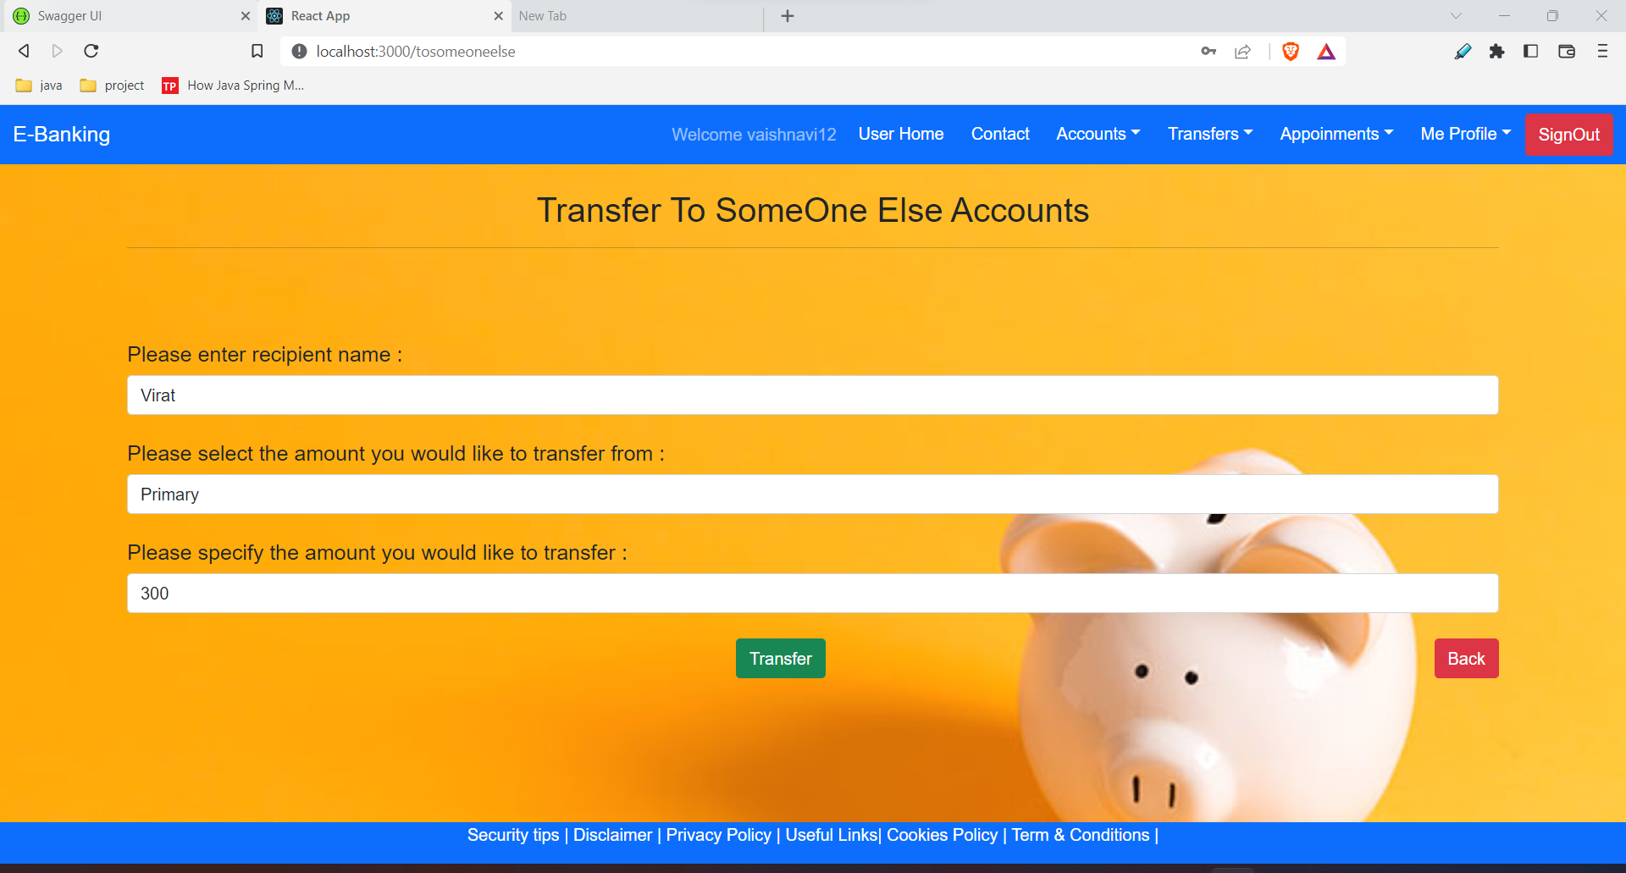

Slide 28
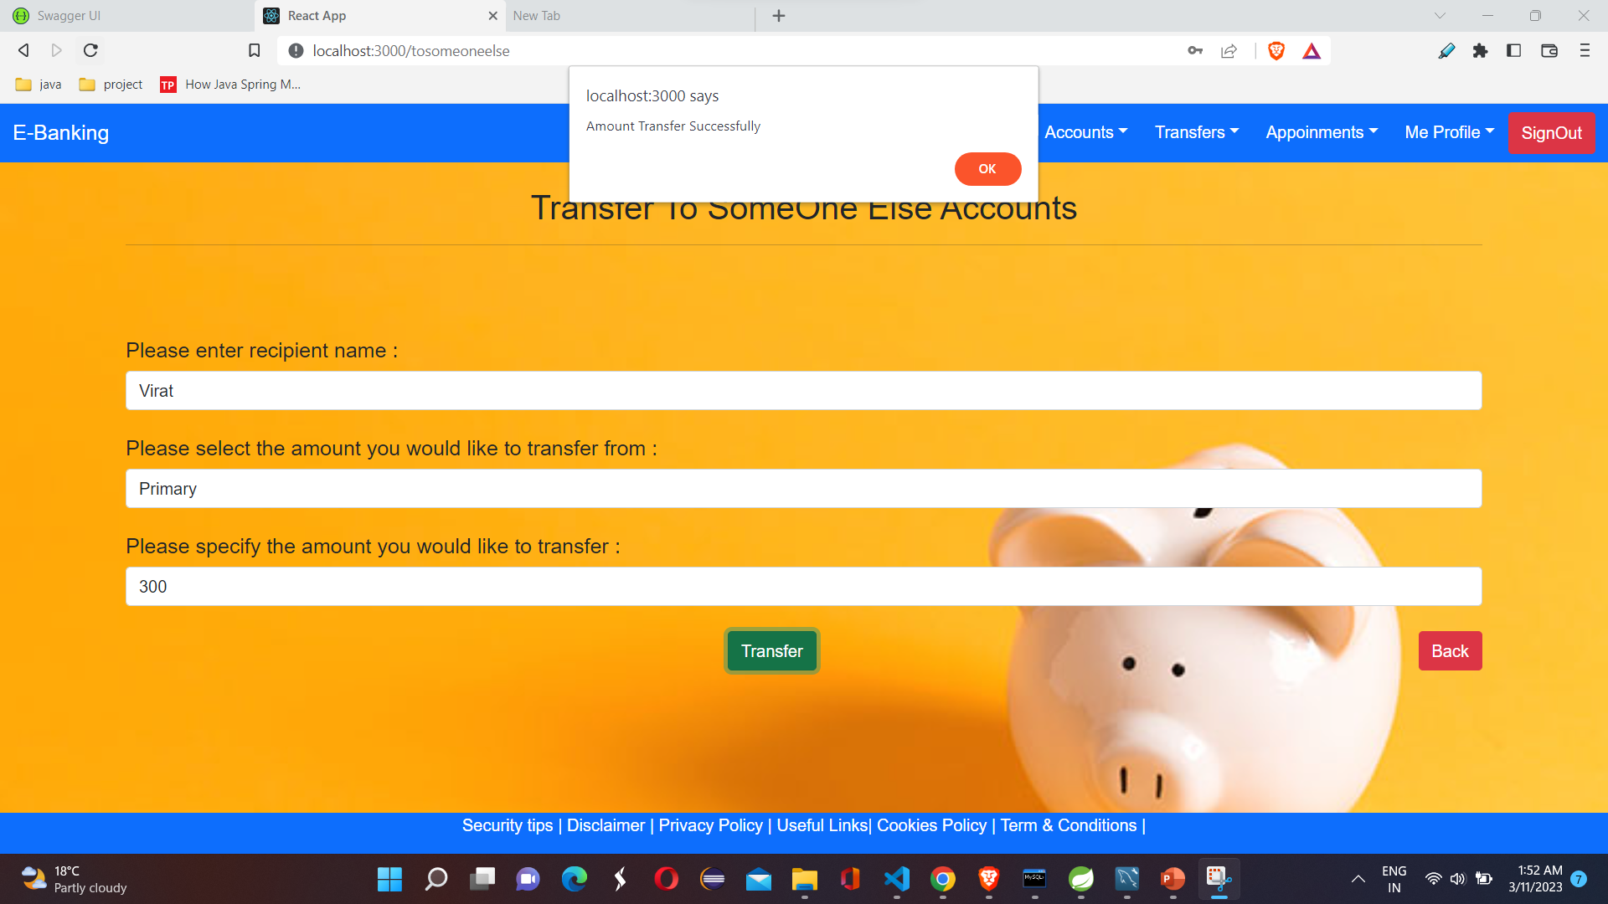

Slide 29
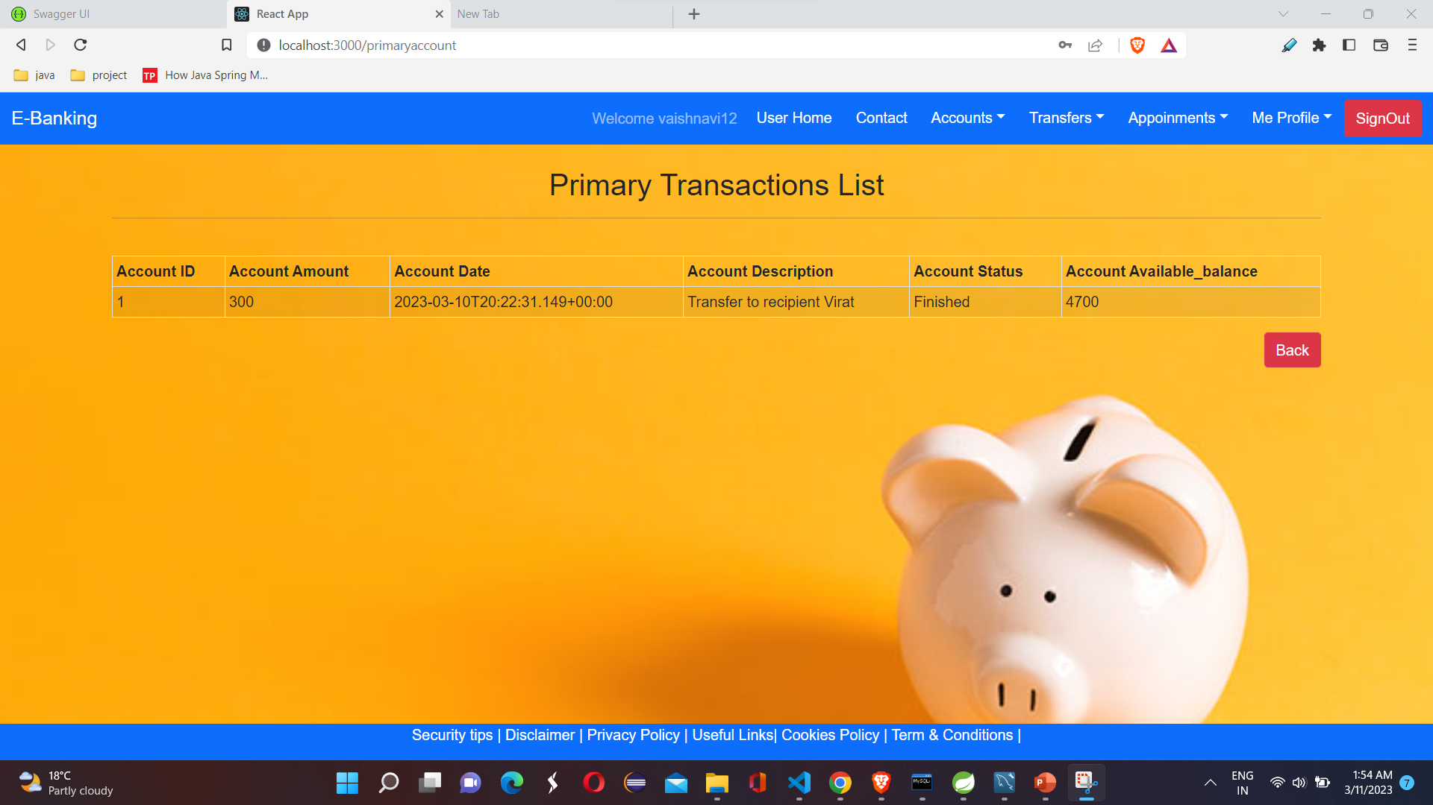

Slide 30
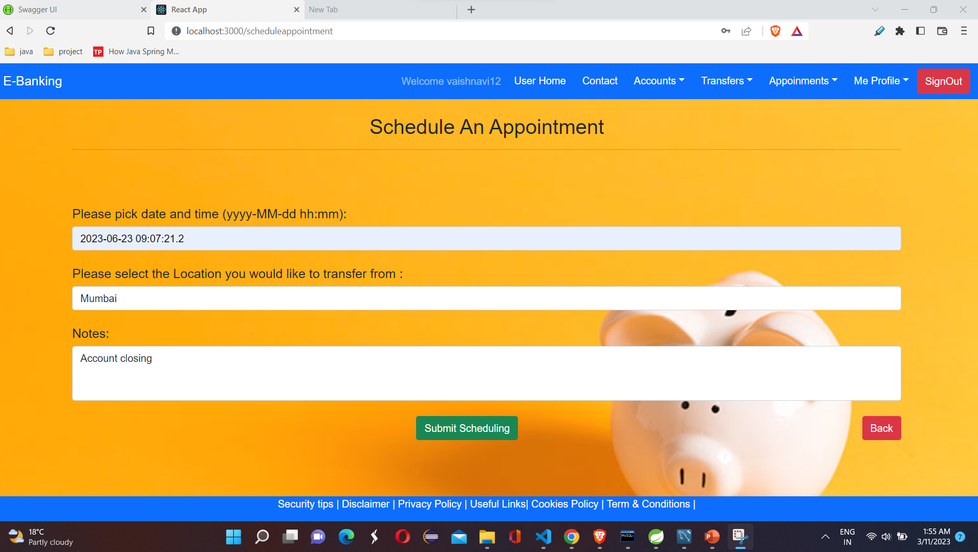

Slide 31
Specification
The application will use Spring-Boot and React as main web technologies.
HTTP is used for communication between clients and servers over the internet
Several types of validations make this web application a secured one and SQL Injections can also be prevented.
Since E-Banking is a web-based application, internet connection must be established.
The E-Banking will be used on PCs and will function via internet or intranet in any web browser.

Slide 32
S/W and H/W Requirements
Server Side:
Processor: Intel® Xeon® processor 3500 series
HDD: Minimum 500GB Disk Space
RAM: Minimum 4GB OS: Windows 10, Linux 6
Database: MySQL
Client Side (minimum requirement):
Processor: Intel Dual Core
HDD: Minimum 80GB Disk Space
RAM: Minimum 2GB
OS: Windows 7, Linux

Slide 33
Advantages
Convenience: E-banking allows customers to access their accounts and perform transactions from the comfort of their own homes or offices. This eliminates the need to physically visit a bank, saving customers time and effort.
Accessibility: E-banking allows customers to access their accounts and perform transactions 24/7, which is especially useful for those who work irregular hours or live far away from a physical bank branch.
Cost-effectiveness: E-banking reduces the need for a large number of physical bank branches, which can be expensive to maintain. This can lead to cost savings for both the bank and the customer.
Improved efficiency: E-banking can automate many banking processes, reducing the need for manual intervention and improving efficiency. This can lead to faster transaction processing times and fewer errors.
Environmental benefits: E-banking reduces the need for customers to drive to physical bank branches, which can reduce carbon emissions and help to protect the environment.
Overall, an e-banking project can provide a range of benefits to both banks and customers, making it a worthwhile investment for many financial institutions.

Slide 34
Disadvantages
Technical difficulties
Security risks
Lack of personal interaction
Fees
Limited access to cash

Slide 35
Conclusion
This project helps banks manage their operations efficiently and effectively. The system provides several benefits such as enhanced security, increased accuracy in transactions, real-time data access, and improved customer service. With the use of an e-bank management system, banks can reduce operational costs and streamline their processes, which in turn, can result in higher profitability. Additionally, this system allows customers to access banking services anytime and anywhere, making it more convenient for them. Overall, an e-bank management system is a valuable investment for any bank seeking to remain competitive in today's digital age

Slide 36
Future Enhancement
This project can be enhanced further by adding payment gateway integration:
Integration with Multiple Payment Gateways, Seamless Payment Processing, Enhanced Security, International Transactions.
The software is flexible enough to be modified and implemented as per future requirements
.

Slide 37
References
https://docs.spring.io/spring-boot/docs/current/reference/htmlsingle/
https://www.w3schools.com/
https://javaee.github.io/javaee-spec/javadocs/
https://www.javatpoint.com/java-mail-api-tutorial
https://reactjs.org/docs/getting-started.html

Slide 38
THANK YOU

